Slide 1
Viruses
AP Biology Chapter 19

Slide 2
What is a virus?
Infectious N.A. enclosed in Proteins
Viral Genomes
4 – Several 100s of genes
DNA or RNA
Single or Double
Linear or Circular

Slide 3
Capsids and Envelopes
Capsid: Protein shell
Shape
Rod
Polyhedral
Capsomeres
Protein Subunits
Viral Envelope
Mask the Capsid
Bacteriophages

Slide 4
Simplified Viral Reproduction
Host Range
Species
Tissues
Viral Infection
Tail injects DNA
Polymerases Replicate
Ribosomes make proteins

Slide 5
Replicative Cycles of Phages
Lytic Cycle
Virulent Phages
Bacterial Resistance
Receptors not recognized
Restriction Nuclease
Lysogenic Cycle
Temperate Phages
Lambda Phages
Injects DNA and forms a circle
Creates Prophage
Binary Fission

Slide 6
Viral Envelopes
Envelope attaches to host
Capsid breaks down
Viral Genome takes control
New Virus emerges
Some remain in nucleus

Slide 7
Retroviruses
Utilize Reverse Transcriptase
Transcribes RNA into DNA
DNA integrated into host chromosome
Provirus
Human Immunodeficiency Virus

Slide 8
Viral Illnesses
Vaccines
Cancer
Oncogenes
Trigger cancerous effects
Proto-oncogenes
Turned on or overexpressed

Slide 9
Viral Relations
Simplistic Infectious agents
Viroid
Circular RNA
Prion
Misfolded proteins
Evolution of Viruses
Plasmids
Transposons

Slide 10
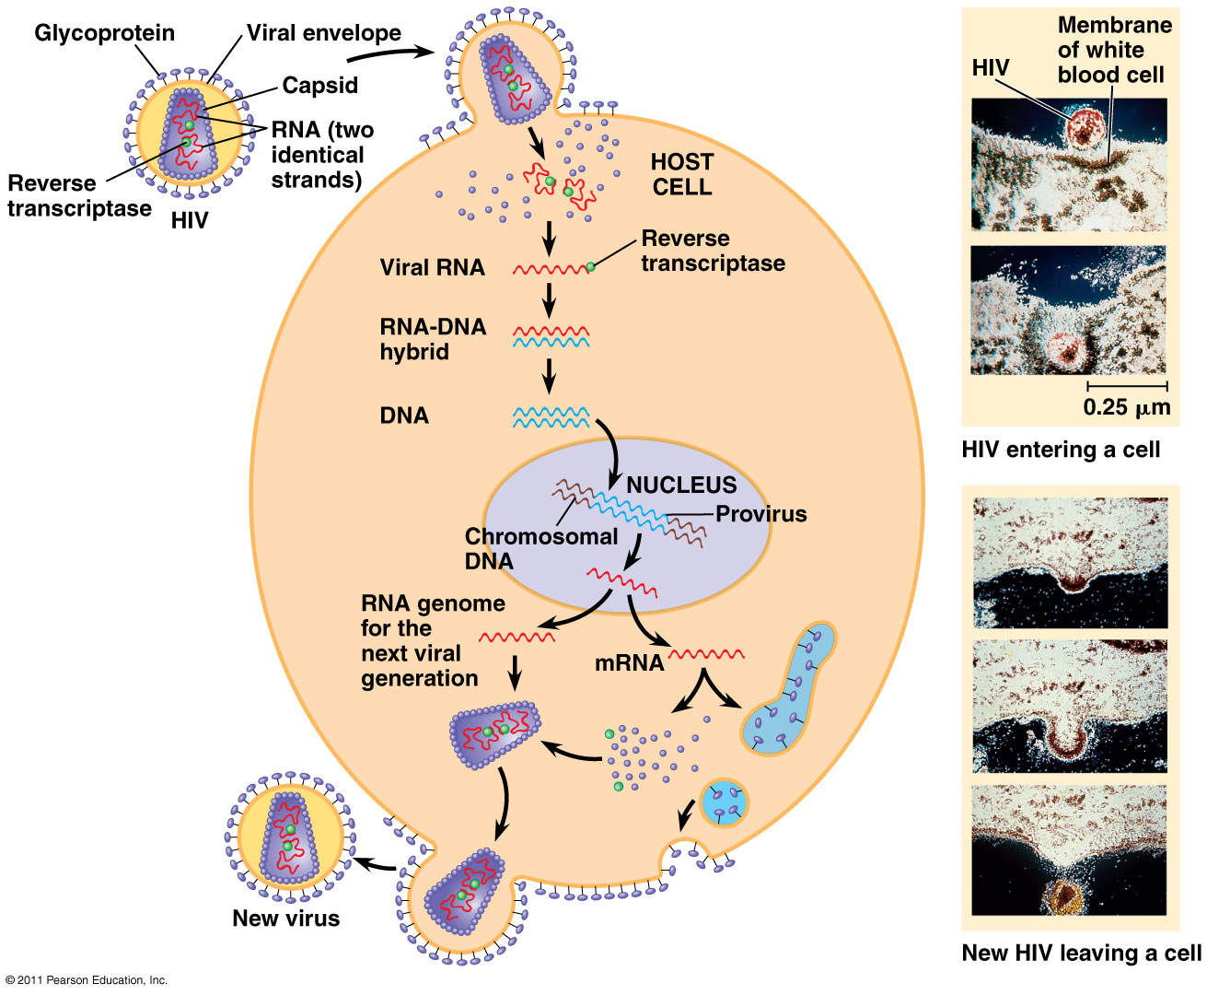
Retrovirus Reproduction

Slide 11
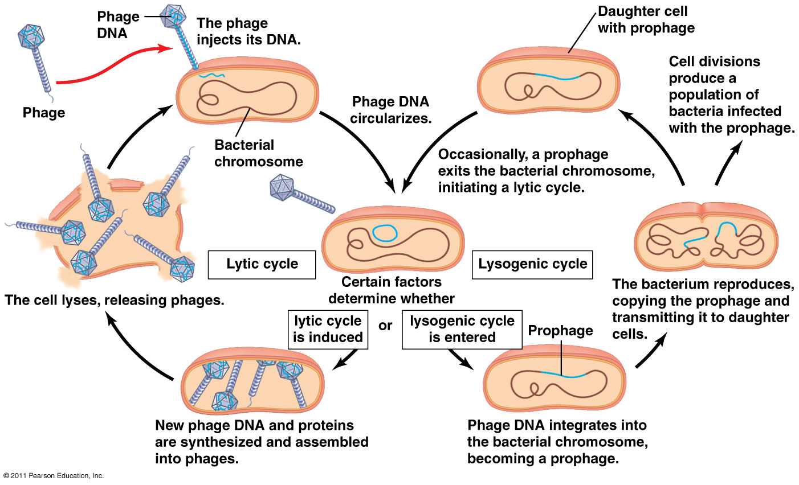
Lysogenic Cycle

Slide 12
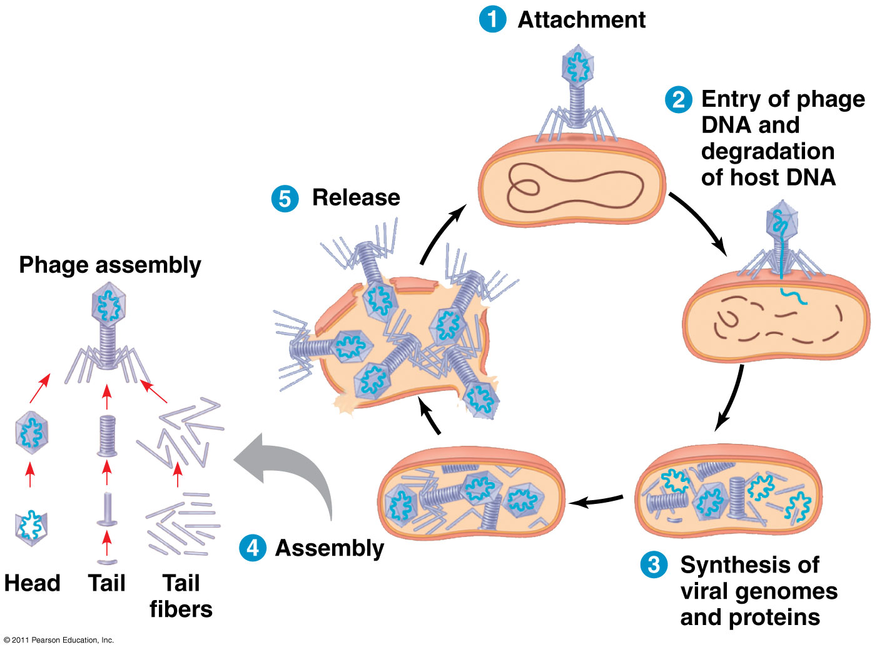
Lytic Cycle

Slide 13
Capsids and Envelopes

