Slide 1
Nervous System
Chapter 48

Slide 2
Role of the Nervous System
Sensory Input
Integration
Motor Output

Slide 3
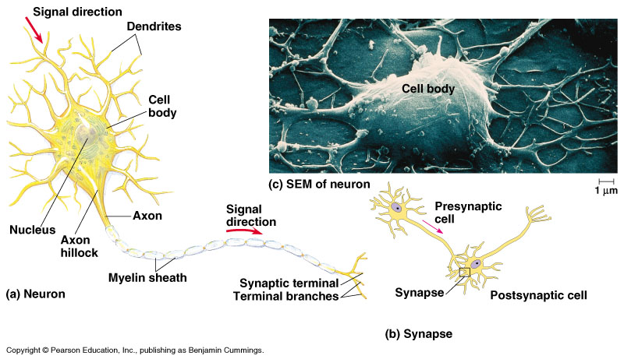
Neuron
Cell Body
Dendrites
Axons
Axon Hillock
Myelin Sheath
Synaptic Terminal
Presynaptic Cell
Postsynaptic Cell

Slide 4
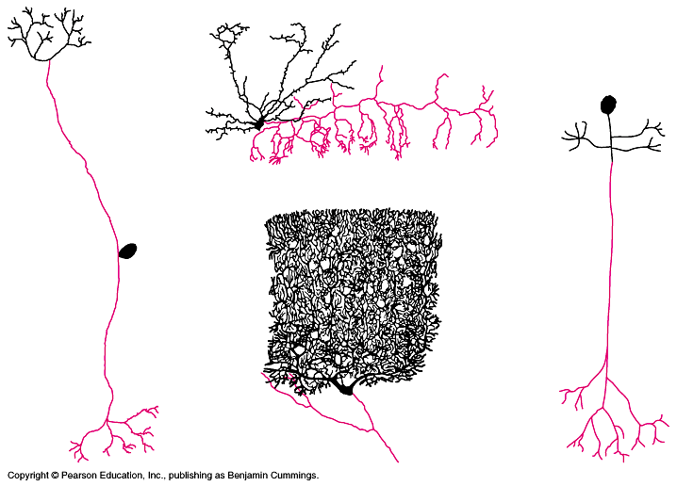
Simple Nerve Circuit
Sensory
Motor
Interneuron

Slide 5
Nerve Circuits
Single source → multiple parts of Brain
Sensory Perception
Circular Pathways

Slide 6
Membrane Potential
Na+ and K+ regulate membrane potential
Resting Potential (-70mV)

Slide 7
Changes in Potential
Hyperpolarization
Depolarization
Action Potential
Threshold Potential
Repolarizes
Refractory Period

Slide 8
Nerve Communication
Electrical Synapse
Chemical Synapse
Depolarize Presyn. Membrane
Release Neurotransmitters
Stimulate Postsyn.

Slide 9
Neural Integration
Excitatory Postsynaptic Potential (EPSP)
Inhibitory Postsynaptic Potential (IPSP)
Summation

Slide 10
Neurotransmitters
Acetylcholine
Biogenic Amines
Epinephrine/Norepinephrine
Dopamine
Serotonin
Chem. NT
Substance P
Endorphins
Gaseous Signals
NO
CO

Slide 11
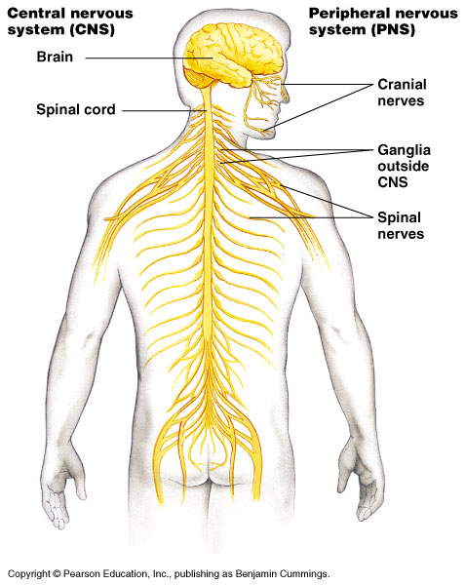
Nervous Systems

Slide 12
Peripheral NS
Sensory
Motor
Somatic
Autonomic
Sympathetic
Parasympathetic

Slide 13
Development of the Brain

Slide 14
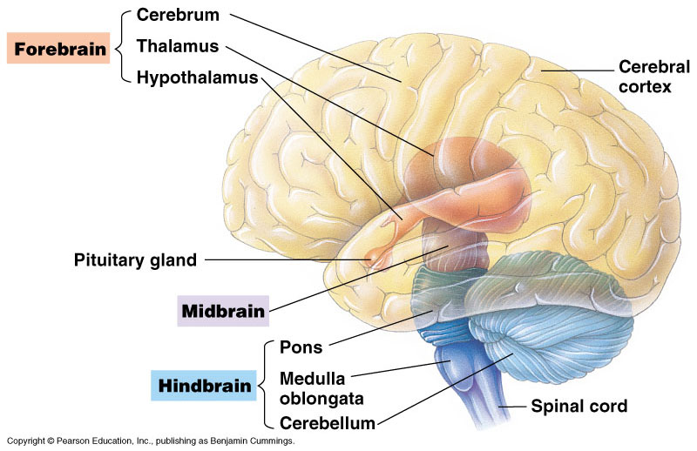
Brainstem
Medulla
Pons
Midbrain

Slide 15
Reticular Activating System (RAS)
Electroencephalogram (EEG)
Alpha Waves
Beta Waves
Delta Waves
REM sleep

Slide 16
Cerebellum
Motor function
Muscle Memory

Slide 17
Cerebrum
Occipital
Temporal
Parietal
Frontal

Slide 18
Lateralization
Left Cerebral Hemisphere
Right Cerebral Hemisphere

Slide 19
Emotions
Limbic
Amygdala
Hippocampus

Slide 20
Memory and Learning
Short Term
Long Term

Slide 21
Cerebrum

Slide 22
Autonomic NS

Slide 23
Neural Integration

Slide 24
Synaptic Gap

