Slide 2
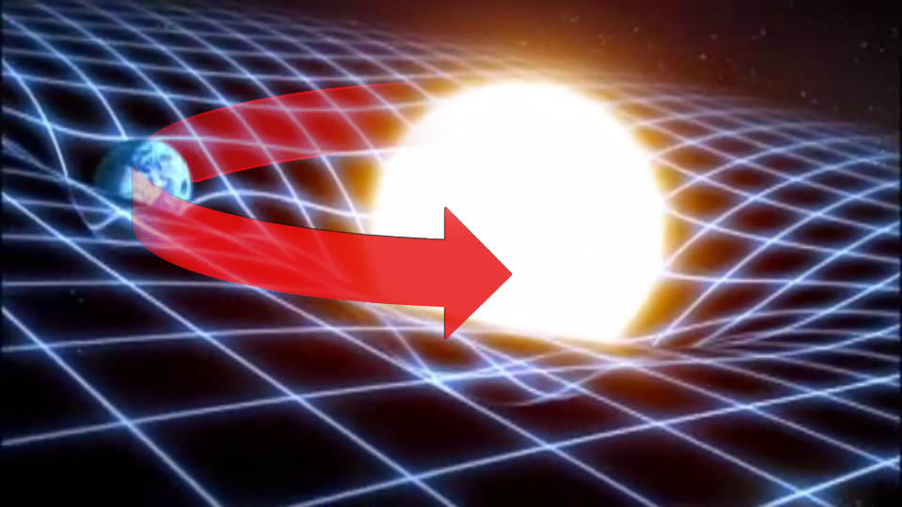
The importance of Gravity

Slide 3
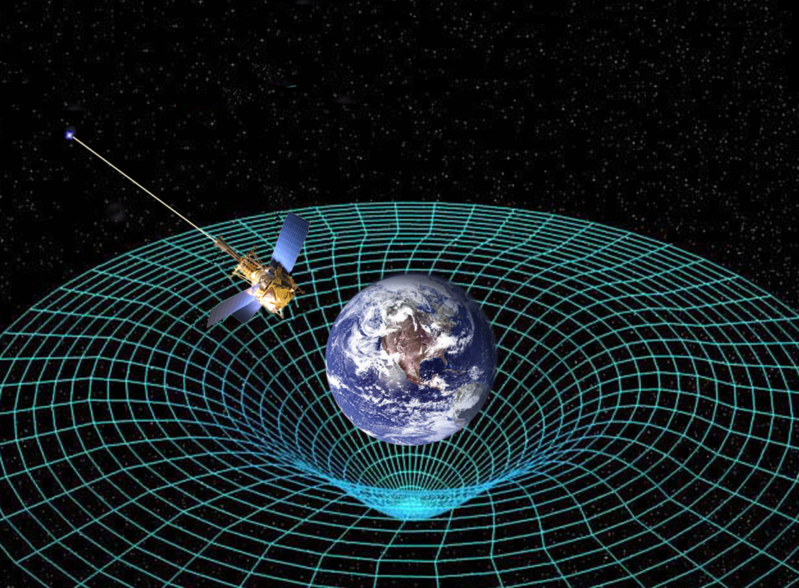

Slide 4
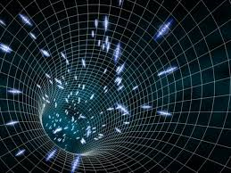
What if gravity is too strong?

Slide 5
Wormholes

Slide 6
What affects Gravitational force?
Directly proportional to the product of the masses of the objects being attracted
Inversely proportional to the distance between the objects squared
$F=G\frac{m1m2}{d^{2}}$

Slide 7
Examples
Two students are sitting 1.50m apart. One student has a mass of 70.0kg and the other has a mass of 52.0kg. What is the gravitational force between them?
(1.08x10-7N)
2. The gravitational force between two objects that are 2.1x10-1m apart is 3.2x10-6N. If the mass of one object is 5.5x101kg, what is the mass of the other object.
38kg

