Slide 1
Regulation of Gene Expression
AP Biology Chapter 18

Slide 2
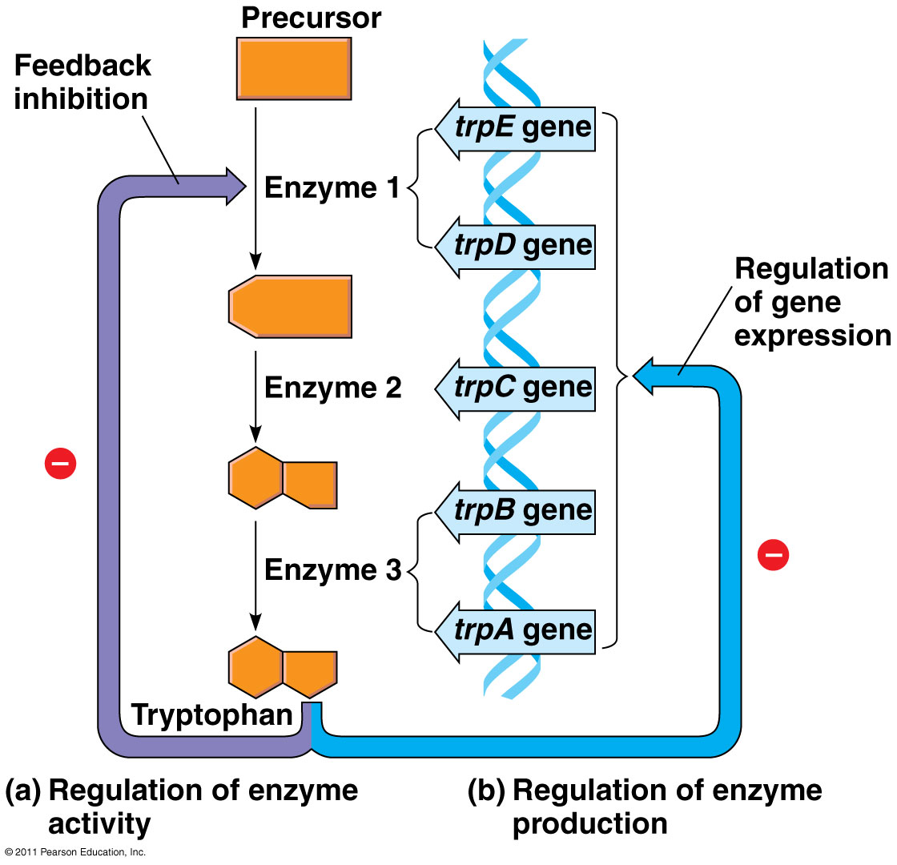
Metabolic Control
Feedback Inhibition
Inhibits Transcription of Enzyme
Repressible Enzymes
  Anabolic Pathways
Inducible Enzymes
  Catabolic Pathways

Slide 3
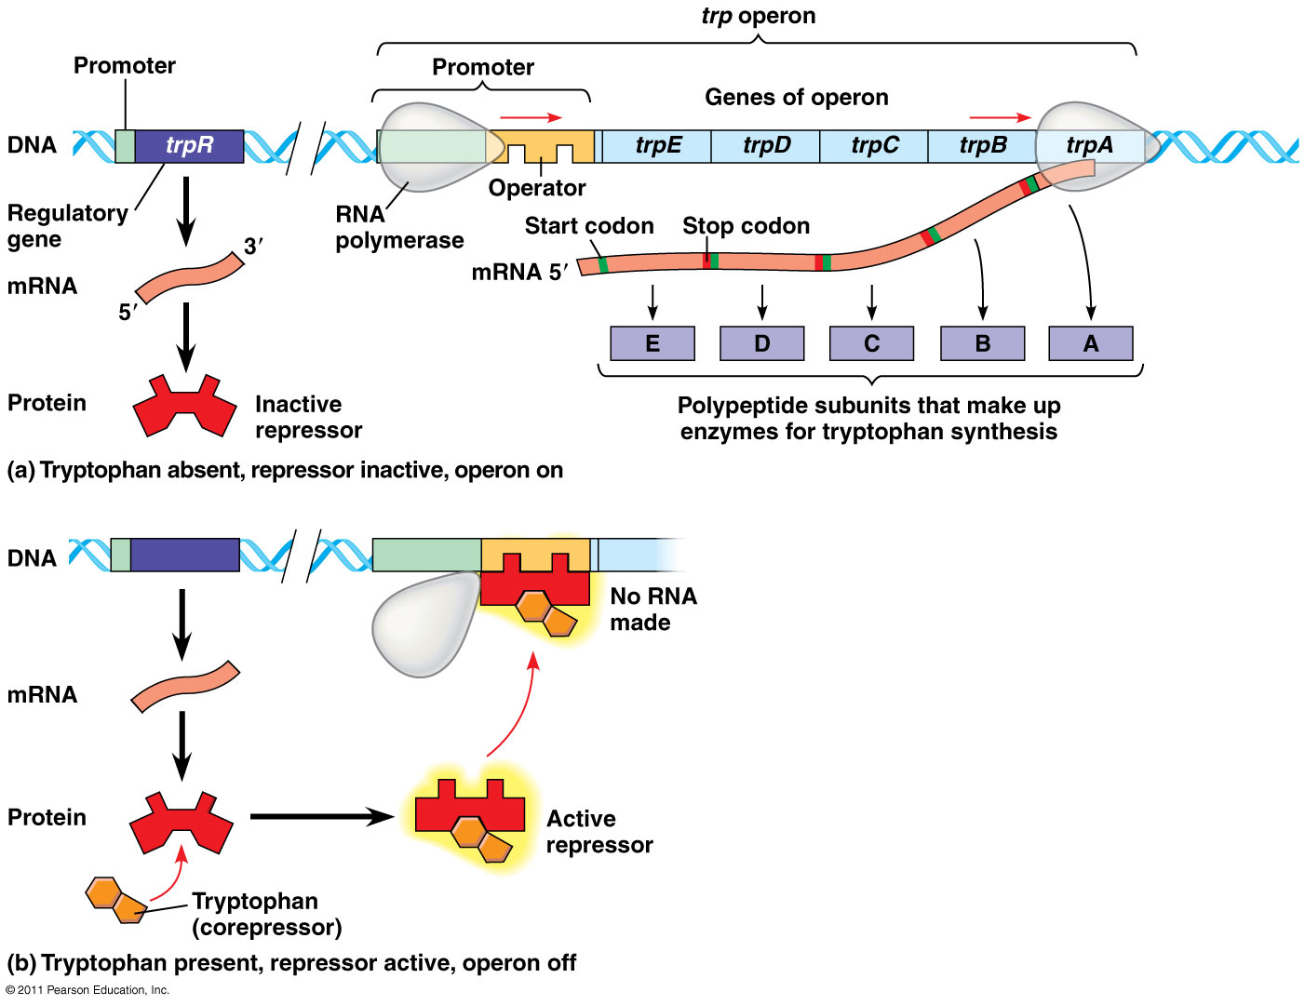
Operons
Transcription Unit
Operator
  Located Upstream
  Limits RNA Polymerase
Promoter
Genes

Slide 4
trp Repressor
“Switches off” by binding to Operator
Created by Regulatory Gene (trp R)
  Repressor present at all times
  Allosteric Protein
    Activated by Tryptophan
    Tryptophan is corepressor

Slide 5
Lac Operon
Repressible and Inducible
Beta-galactosidase present in small amounts
Lac I codes for lac Repressor
Inactivated by Allolactose

Slide 6
Positive Gene Regulation
cAMP accumulates as glucose decreases
Activator of Catabolite Activator Protein
CAP binds upstream of promoter
Increases Affinity for RNA Polymerase

Slide 7
Eukaryotic Gene Expression Regulation
Differential Gene Expression
Regulation of Chromatin Structure
Regulation of Transcription Initiation
Post-Translational Regulation

Slide 8
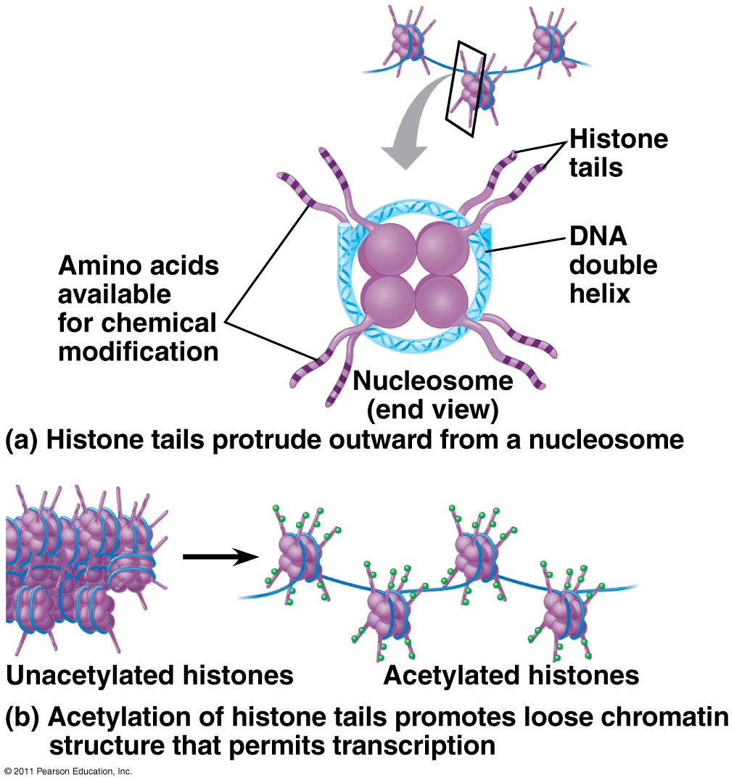
Histone Modification
N-terminus protrudes from nucleosome
Histone Acetylation
  Added to Histone Tail
  Neutralizes Lysine
  Chromatin loosens
Histone Methylation Condenses
PO₄ added next to CH₃ decondenses

Slide 9
DNA Methylation
Usually methylates Cytosine
Inactivates genes/genes
  X-inactivation
Methylation copied after replication
  Genomic Imprinting

Slide 10
Regulation of Transcription Initiation
Organization of a Eukaryotic Gene
  Control Elements
Roles of Transcription Factors
  General TFs
    Few bind to DNA
    Most bind other proteins
  Specific TFs
    Cause High Levels of Transcription
    Certain genes at certain times
Enhancers and Specific TFs
  Proximal Control Centers
    Considered promoter
  Distal Control Centers
    Enhancers
    Expression rates increases through binding
    How they work
      Activators bind
      DNA bends
      Help mediators form TIC

Slide 11
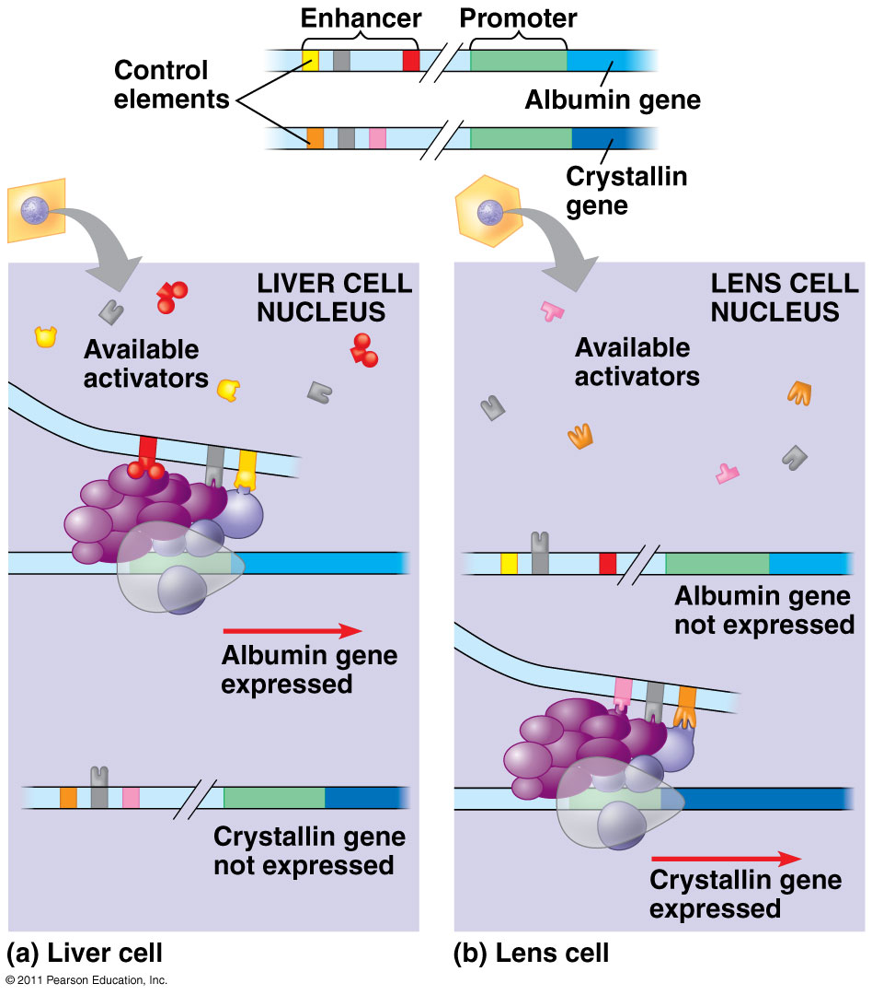
Combinatorial Control of Gene Activation

Slide 12
Coordinately Controlled Genes in Eukaryotes
Cooperative Genes may be located on different chromosomes and dispersed throughout the genome
Specific Combinations for ALL dispersed genes
Hormones stimulate through Hormone-Receptor Complex

Slide 13
Post-Translational Regulation
RNA Processing
mRNA Degredation
  Control found in UTR
Initiation of Translation
Protein Processing and Degradation
  Processing
    Cleavage of Pro-Insulin
    Phophorylation
  Degradation
    Ubiquitin attaches to protein
    Proteasomes degrade tagged proteins

Slide 14
Noncoding RNAs and Gene Regulation
microRNAs (miRNAs)
  RNA creates a hairpin
  Dicer trims RNA hairpin
  One strand degraded
  Binds with protein
    mRNA degraded (perfect)
    Translation blocked (imperfect)
RNA interference (RNAi): expression turned off
  Small interfering RNAs (siRNAs)

Slide 15
Differential Gene Expression leads to Different Cell Types
Cell Division
  Creates new cells
  Determines the fate of particular cells
Differentiation
  Specialization
Morphogenesis
  Arranges cells into tissues

Slide 16
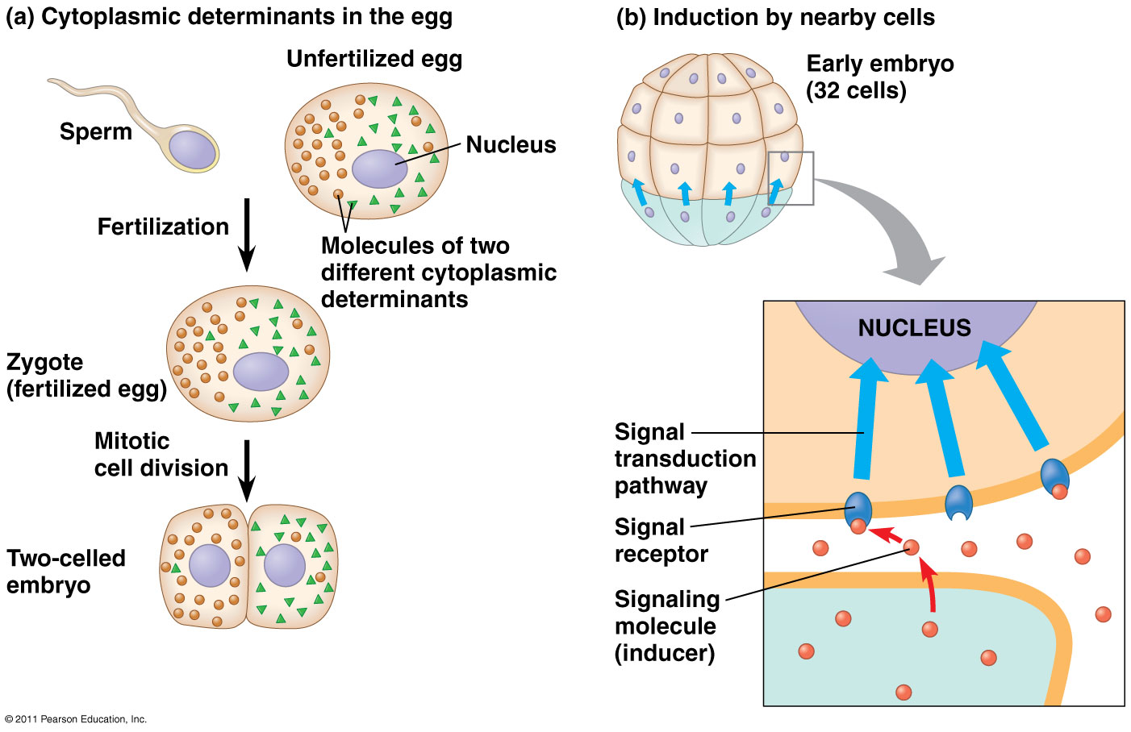
Cytoplasmic Determinants and Inductive Signals
Cytoplasmic Determinants
  Non-homogenous cytoplasm in the egg
  Concentrations determine cell fate
Induction
  Inducers released from nearby cells
  Receptors begin signal Transduction Pathway

Slide 17
Setting up the Body Plan
Edward B. Lewis discovered Homeotic Genes
Nusslein-Volhard and Wieschaus identified segmentation genes
Axis Establishment
  Maternal effect genes controlled offspring phenotypes
  Egg Polarity Genes

Slide 18
Cancer
Results from genetic changes that affect cell cycle control
Types of Genes associated with Cancer
  Proto-oncogenes stimulate normal growth
    Ras gene
    Movement of DNA within a genome
    Amplified expression of Proto-oncogenes
    Point Mutations in control elements
  Tumor Suppressor Genes
    P53 gene

Slide 19
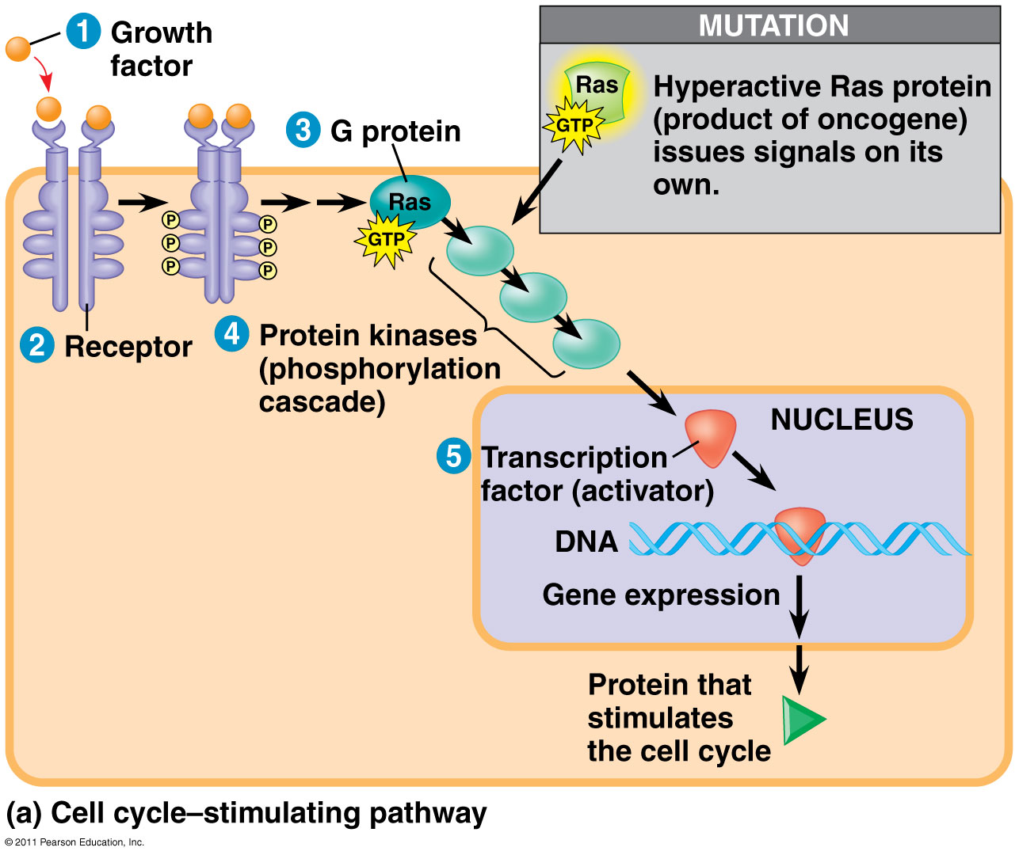
ras gene
Makes ras protein
Growth factor binds to receptor
Activates Ras
  G protein active when attached to GTP
  Starts Kinase Cascade

Slide 20
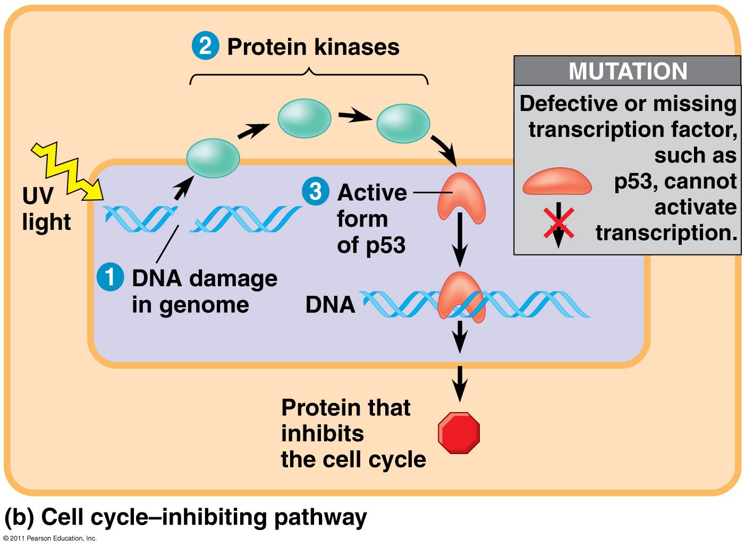
p53 gene
Activates p21
  Binds to CDKs preventing mitosis
Turns on genes for DNA repair
Activates “suicide” genes

Slide 21
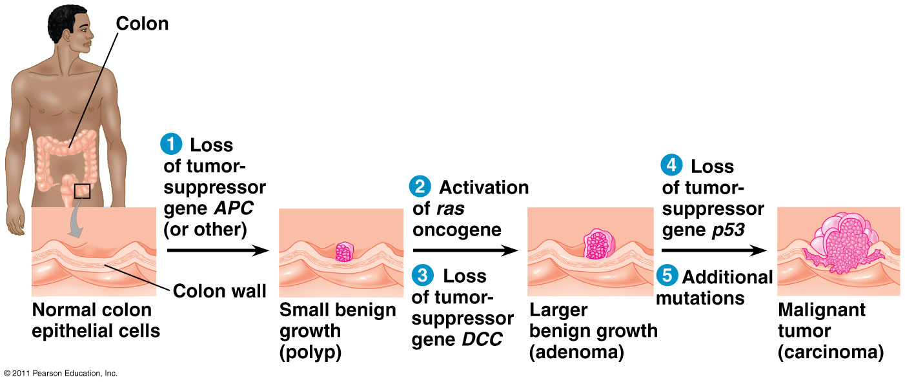
Cancer Development

Slide 22
p53 gene

Slide 23
Ras gene

Slide 24
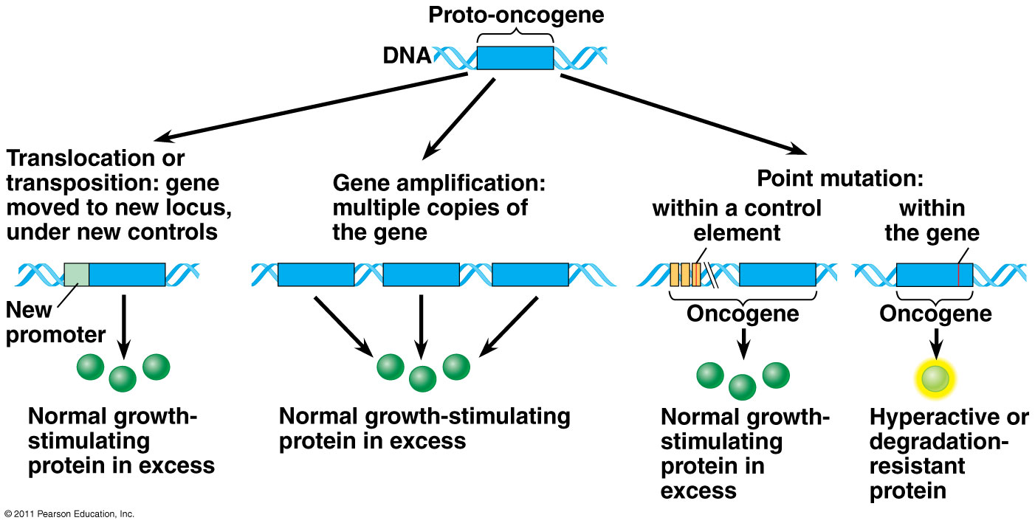
Proto-oncogenes and Cancer

Slide 25
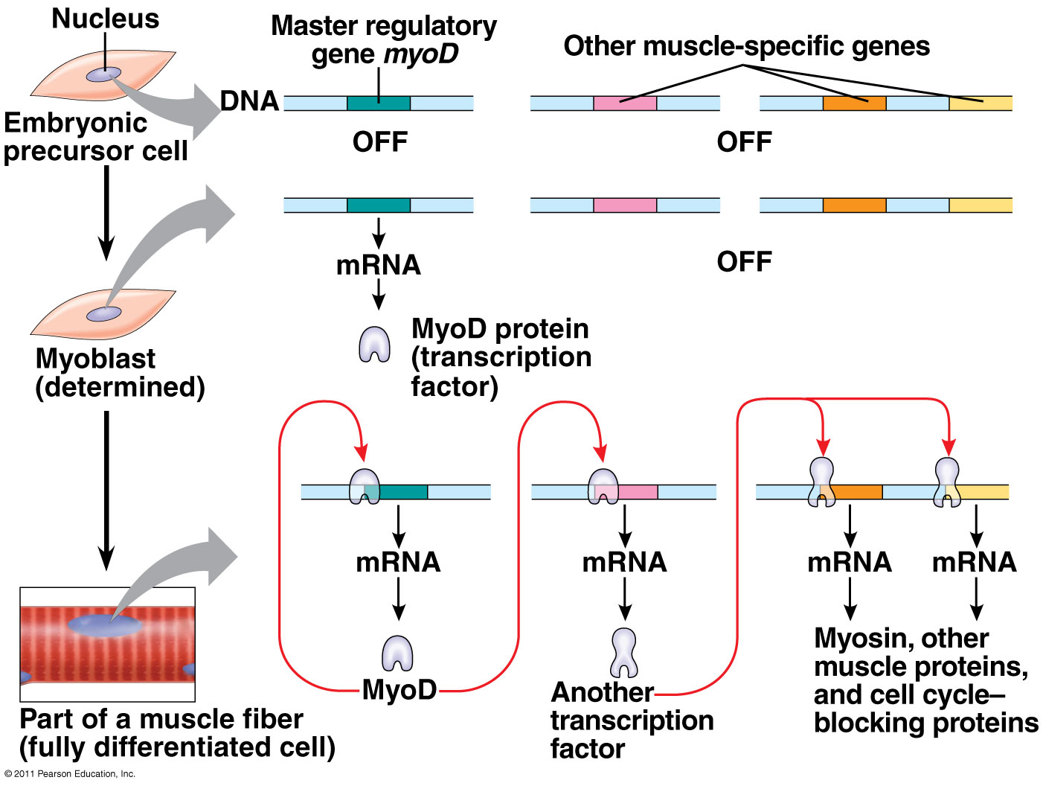
Sequential Regulation for Differentiation

Slide 26
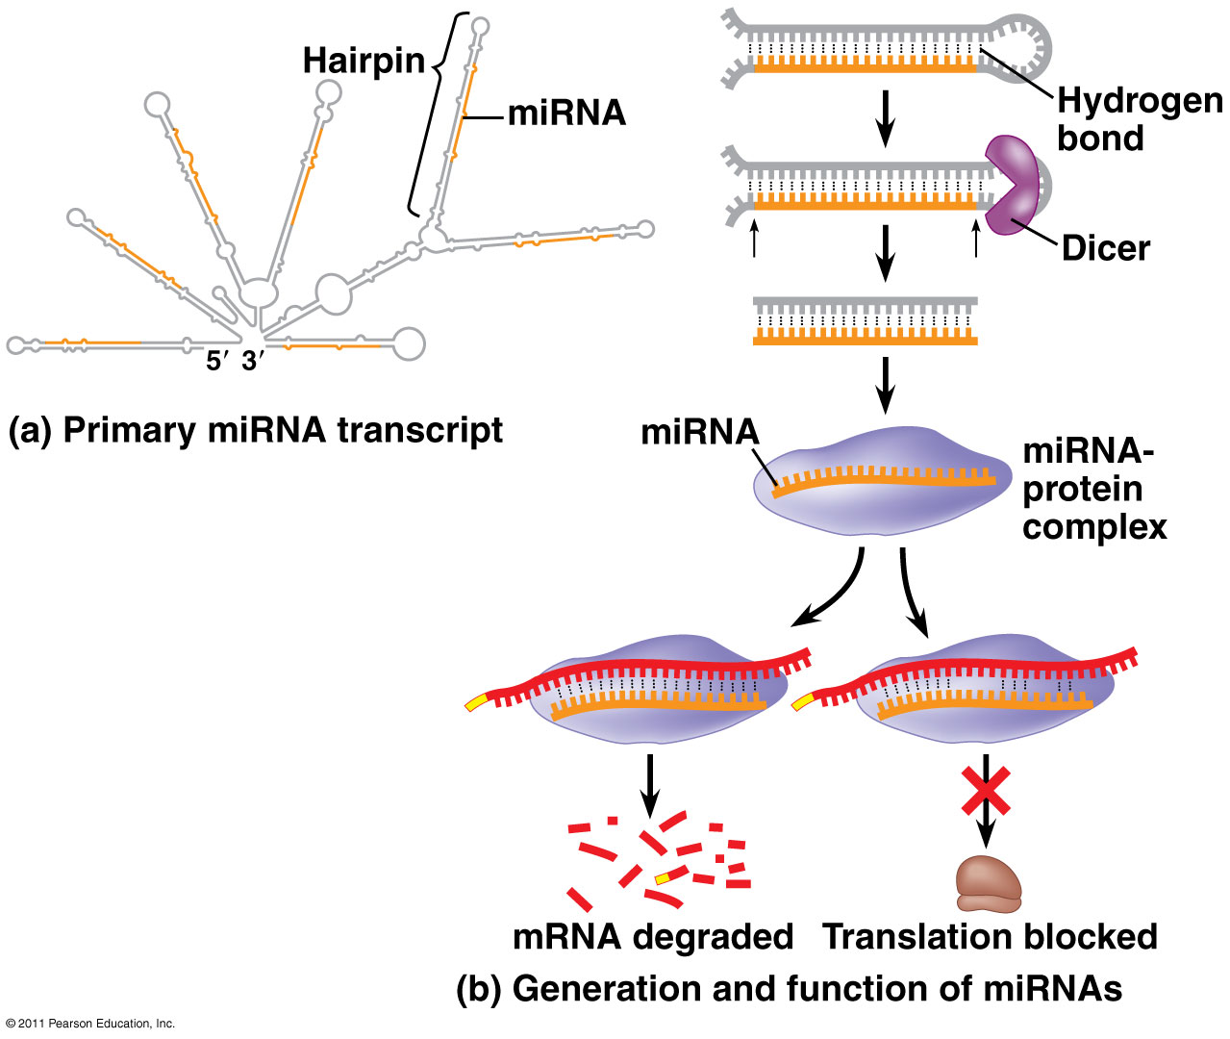
miRNAs

Slide 27
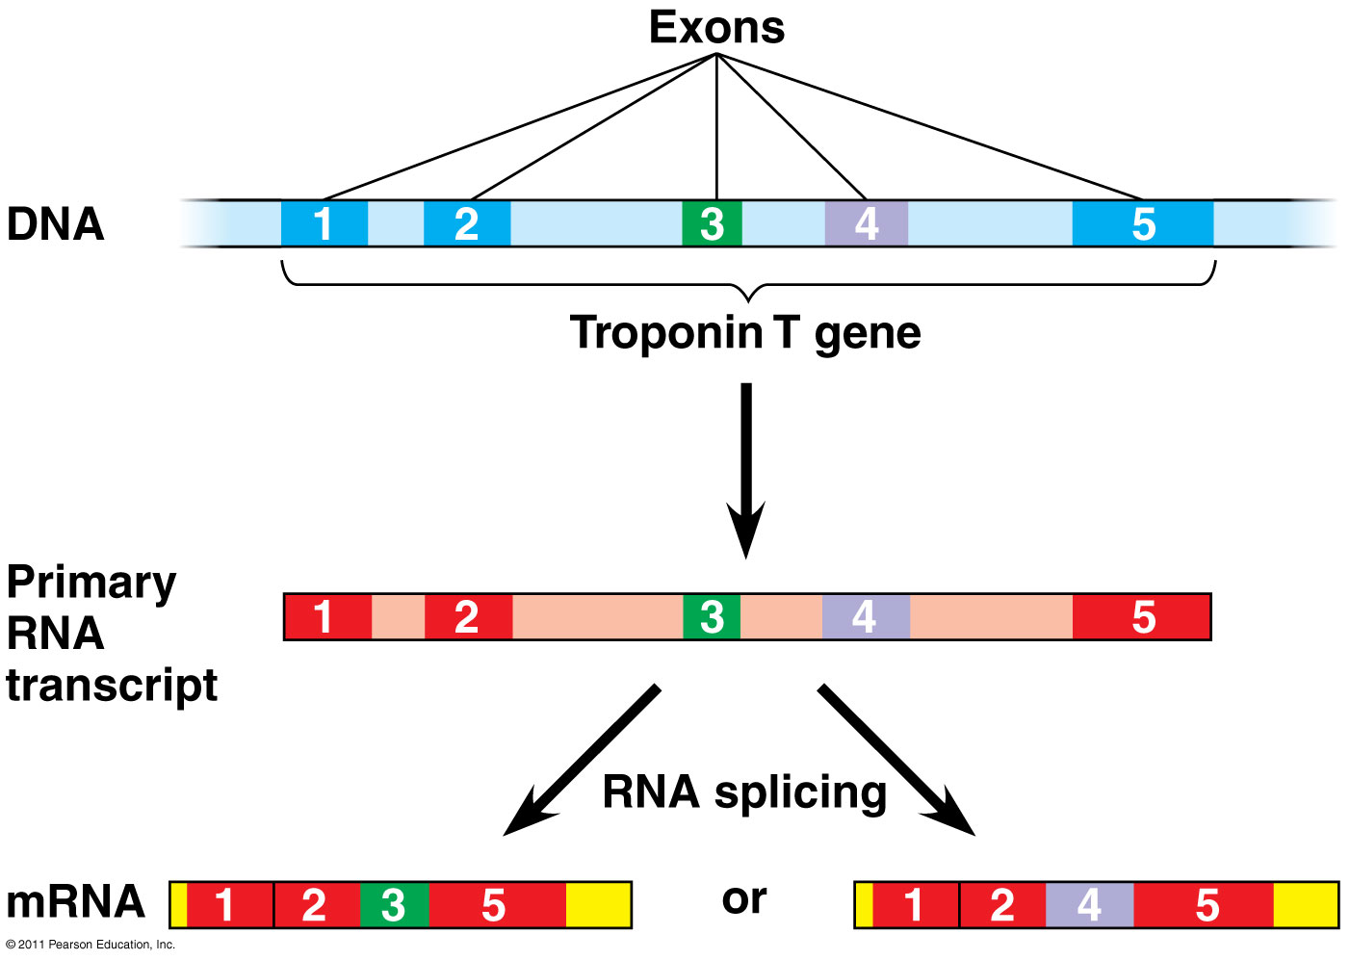
Alternative Splicing

Slide 28
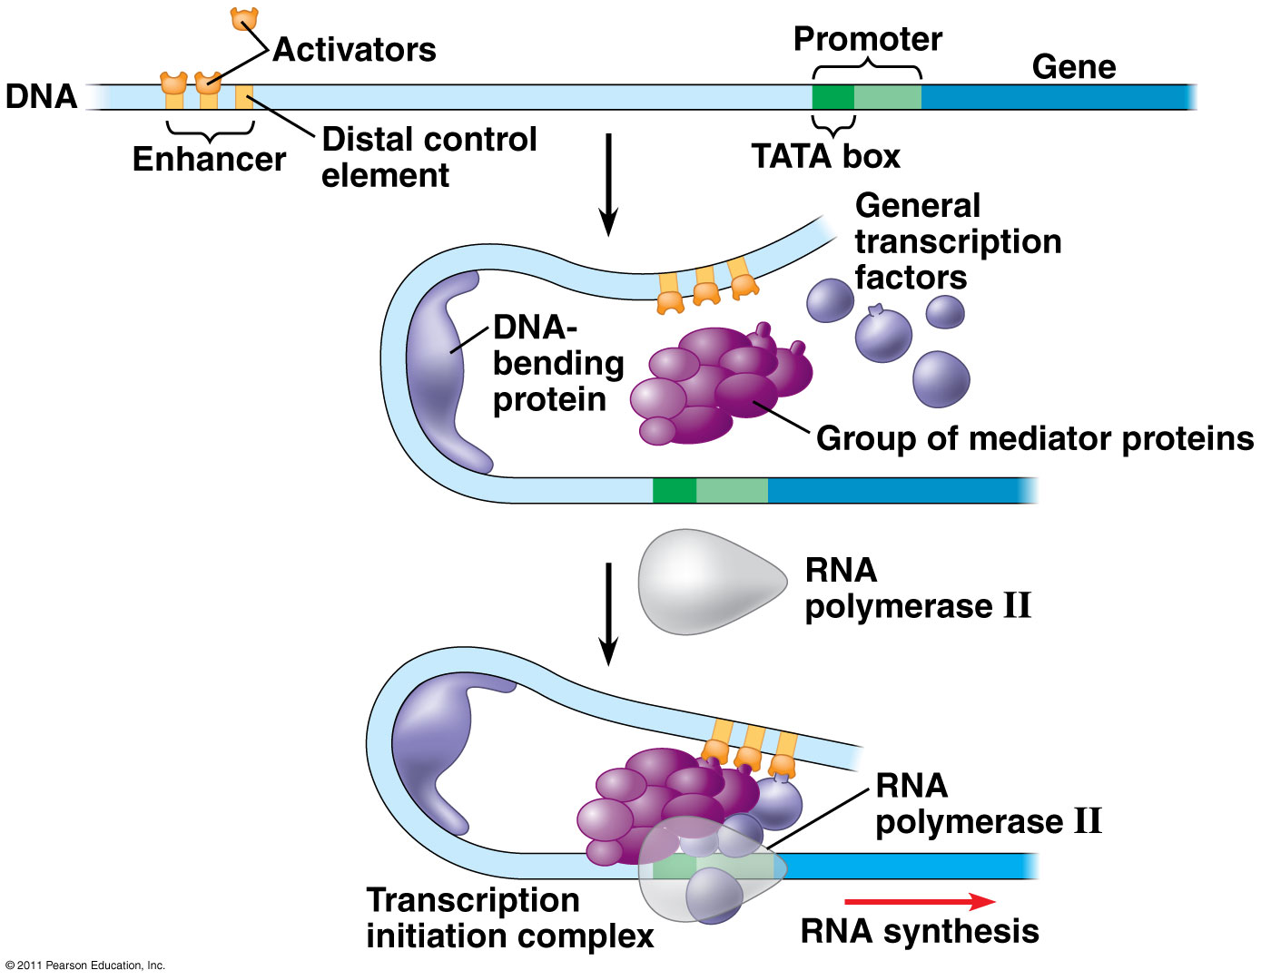
Enhancers

Slide 29
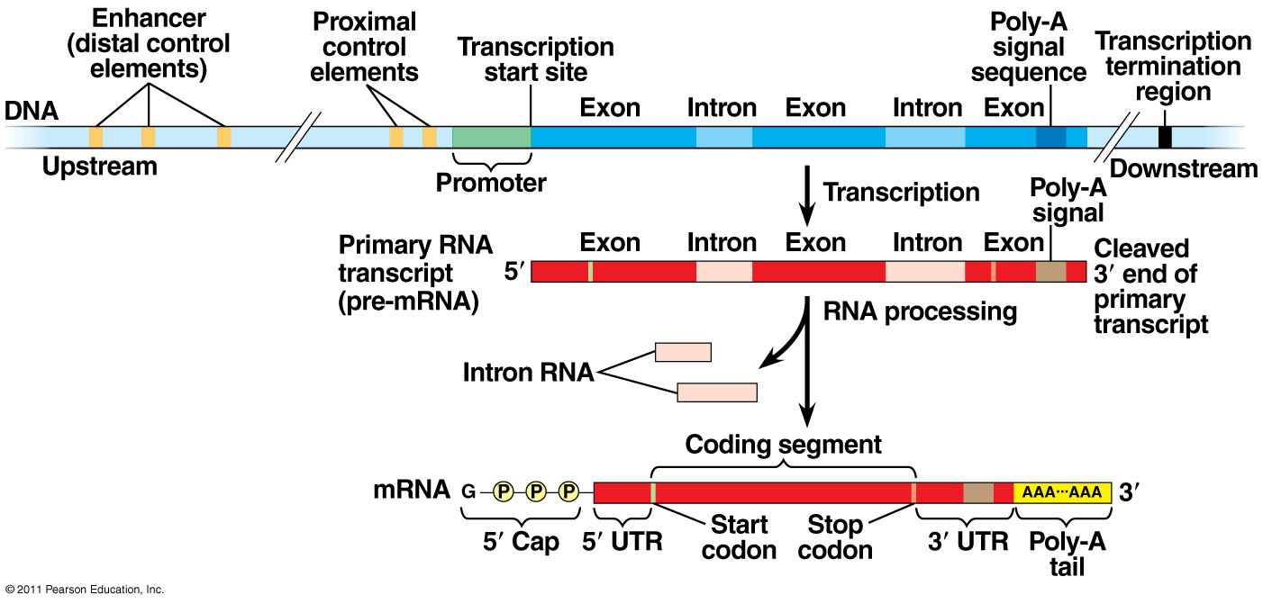
Eukaryotic Gene

Slide 30
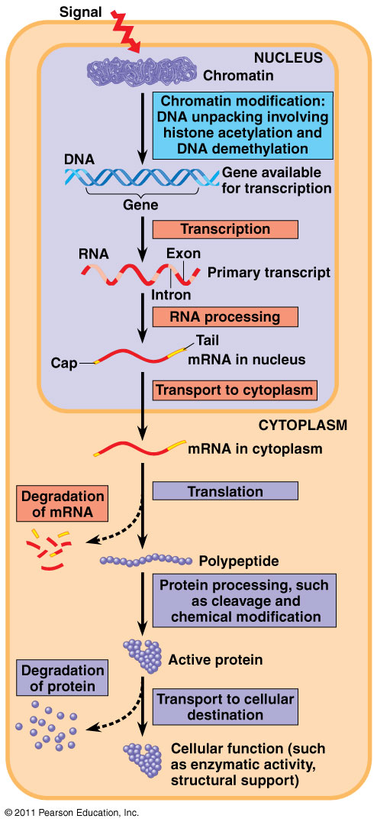
Differential Gene Expression

Slide 31
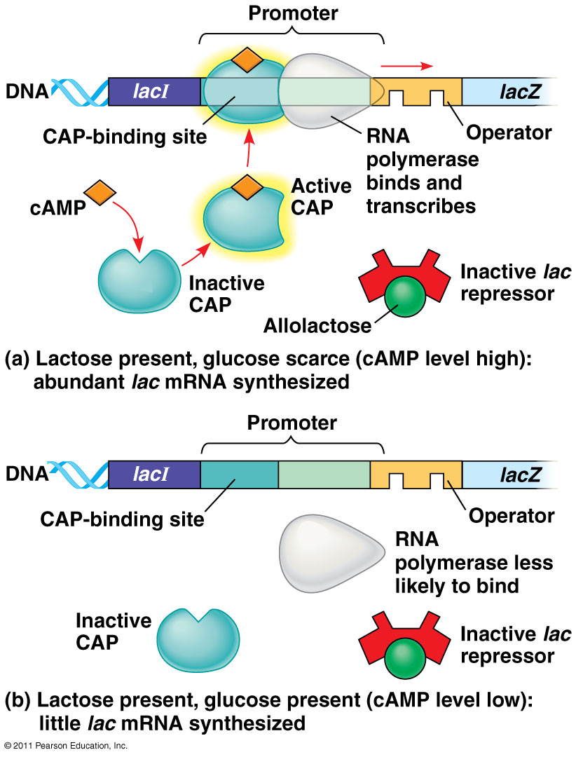
Lac Operon and CAP

Slide 32
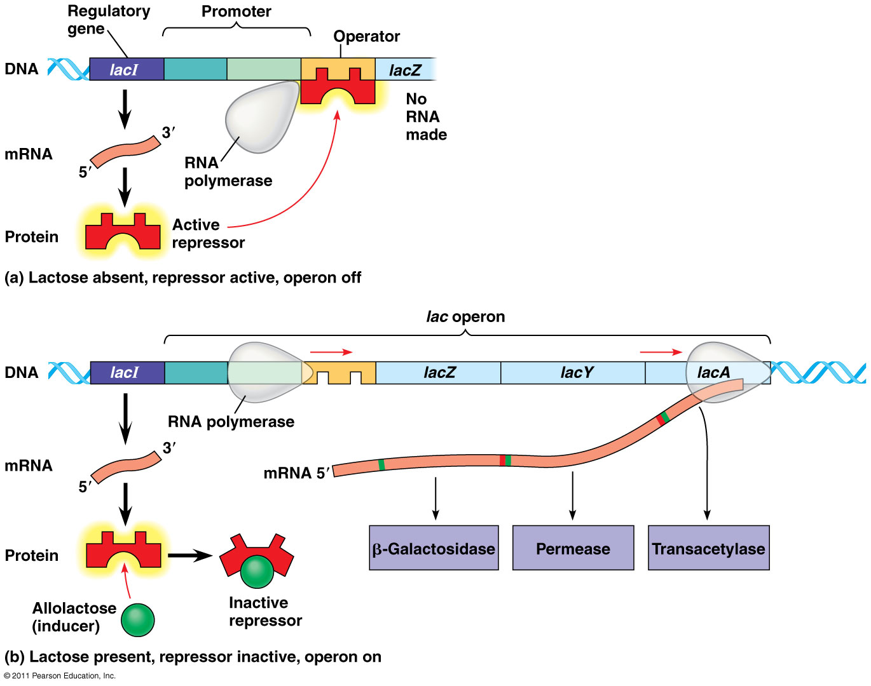
Lac Operon

Slide 33
trp Operon

