Slide 1
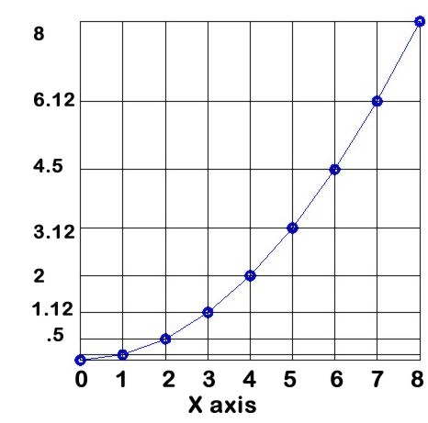
Parabolic Curve
Equation
y$=kx^{2}$
Relationship
y varies as the square of x
y varies with x²
y is proportional to x²

Slide 2
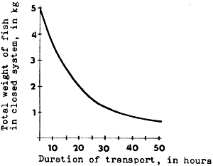
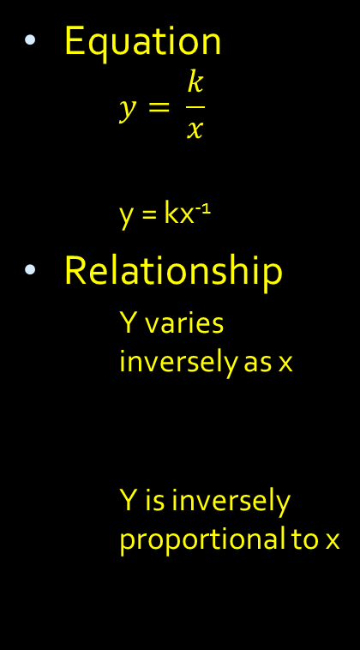
Hyperbolic Curve
Equation
$$y= \frac{k}{x}$$
y = kx⁻¹
Relationship
Y varies inversely as x
Y is inversely proportional to x

Slide 3
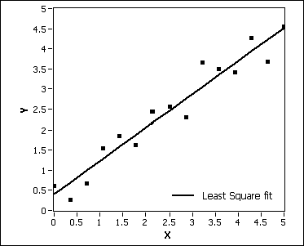
Linear Graph
Equation
$$y=kx$$
Relationship
Y varies directly with x
Y is directly proportional to x

Slide 4
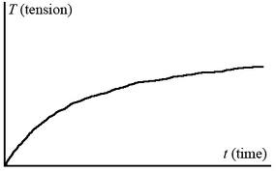
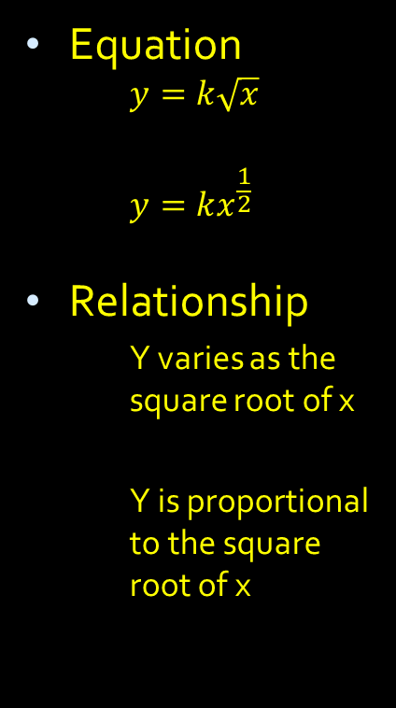
Root Curve
Equation
$$y=k\sqrt{x}$$
$$y=kx^{\frac{1}{2}}$$
Relationship
Y varies as the square root of x
Y is proportional to the square root of x

